Slide 1
SARS-CoV-2 host adaptation

Slide 2
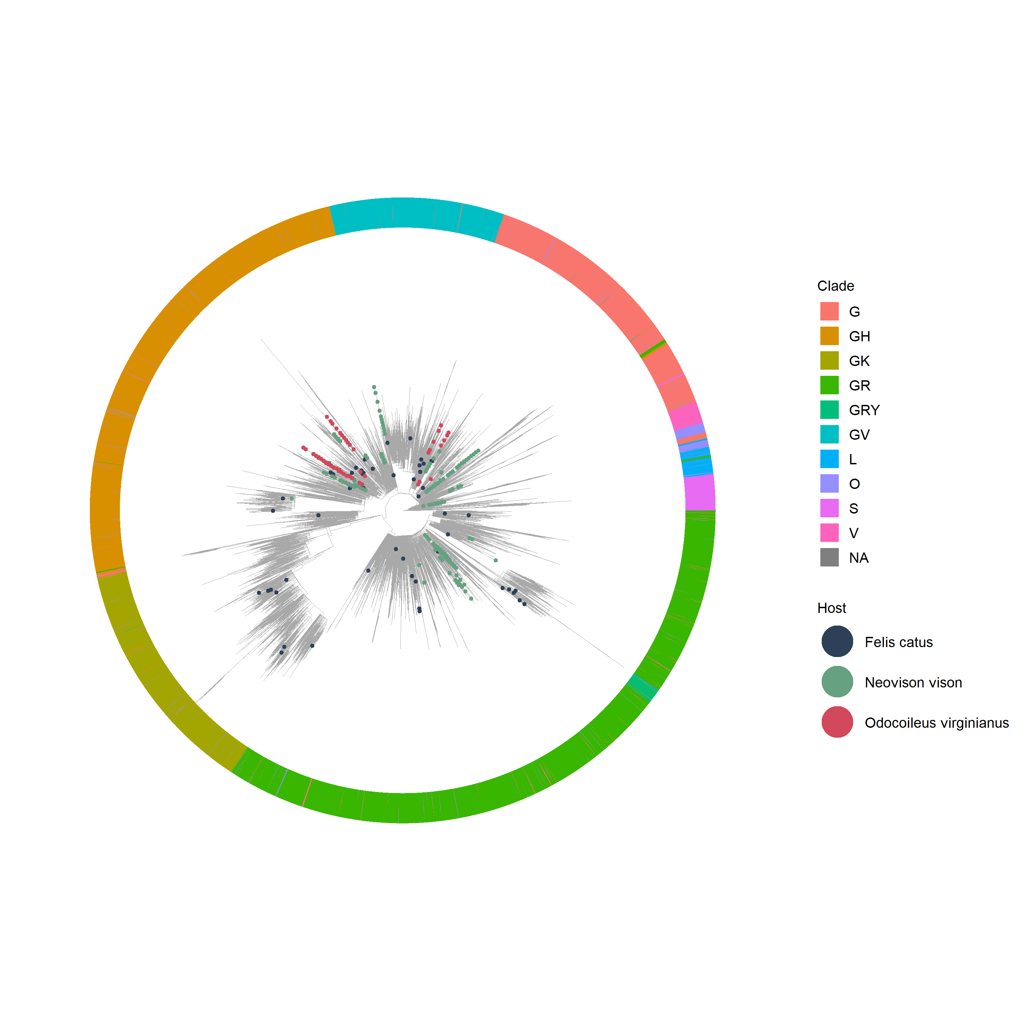
Global phylogeny (subset, n = 100)

Slide 3
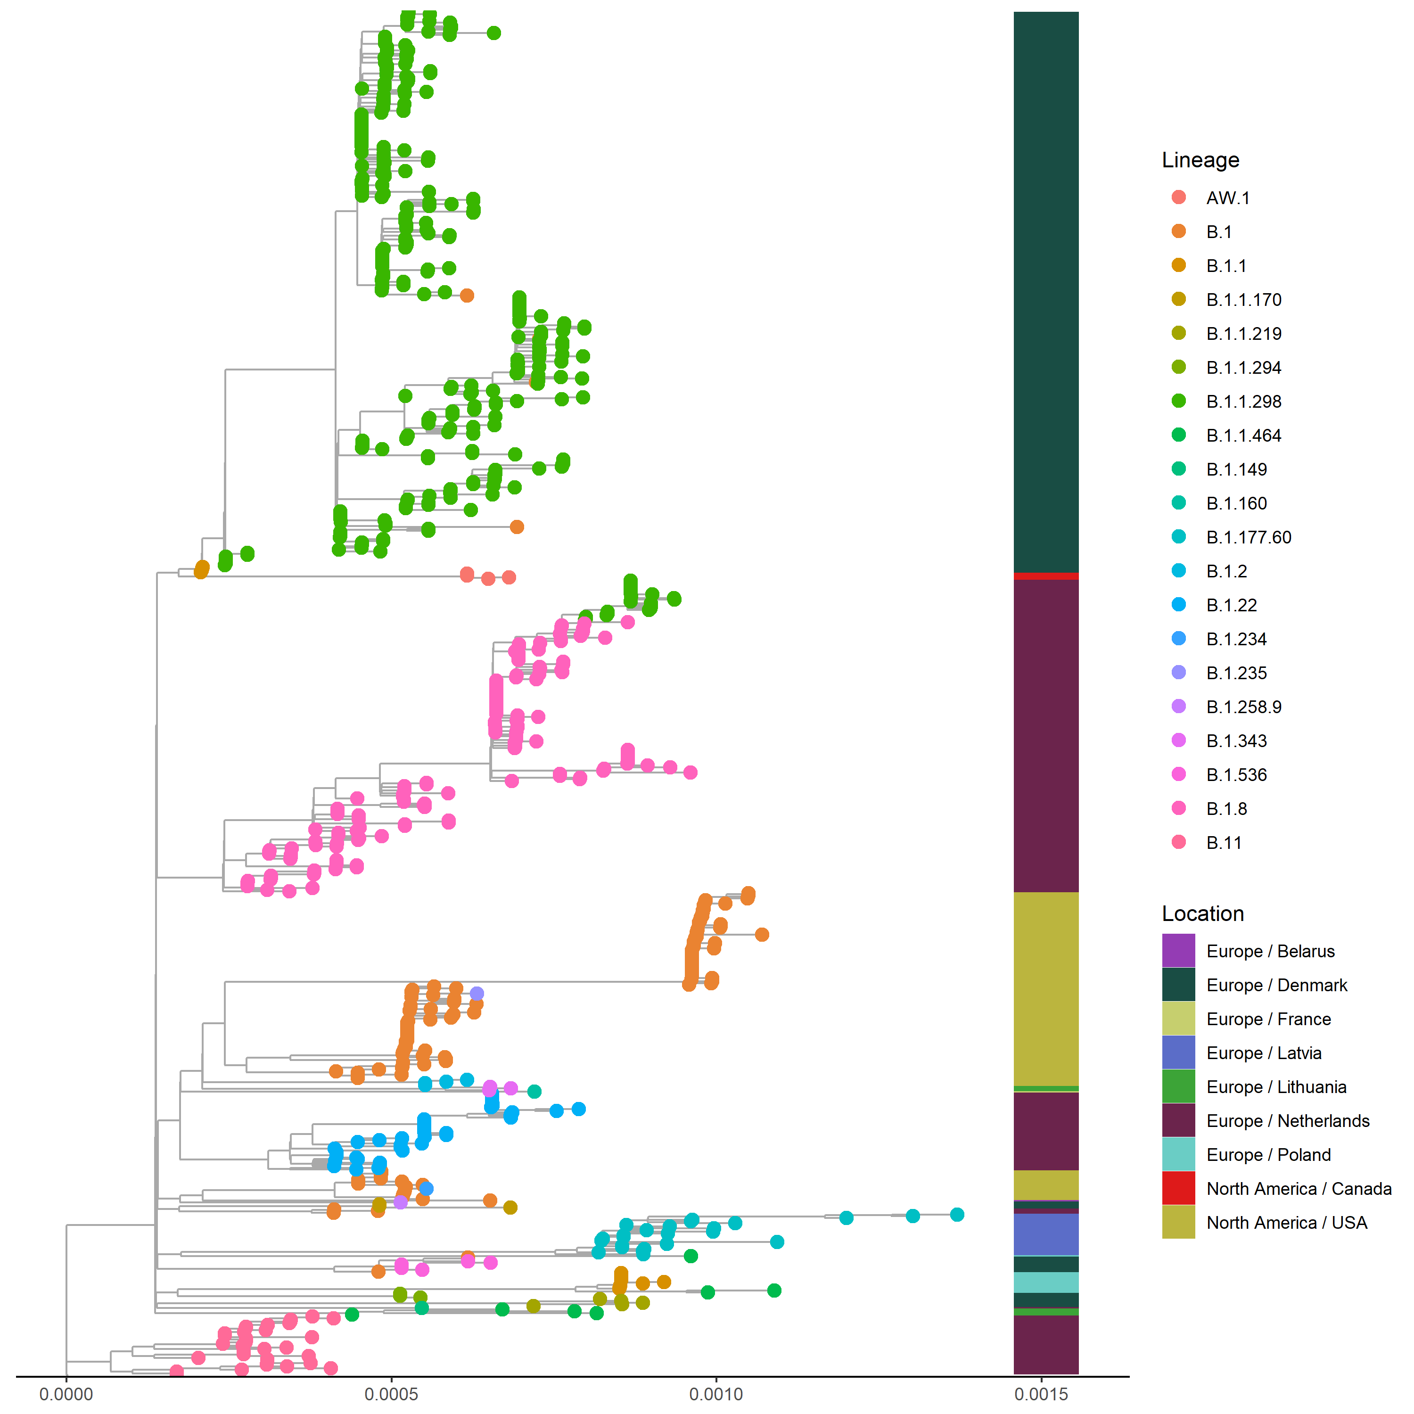
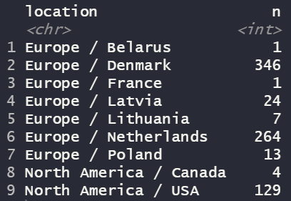
Mink (n=789)

Slide 4
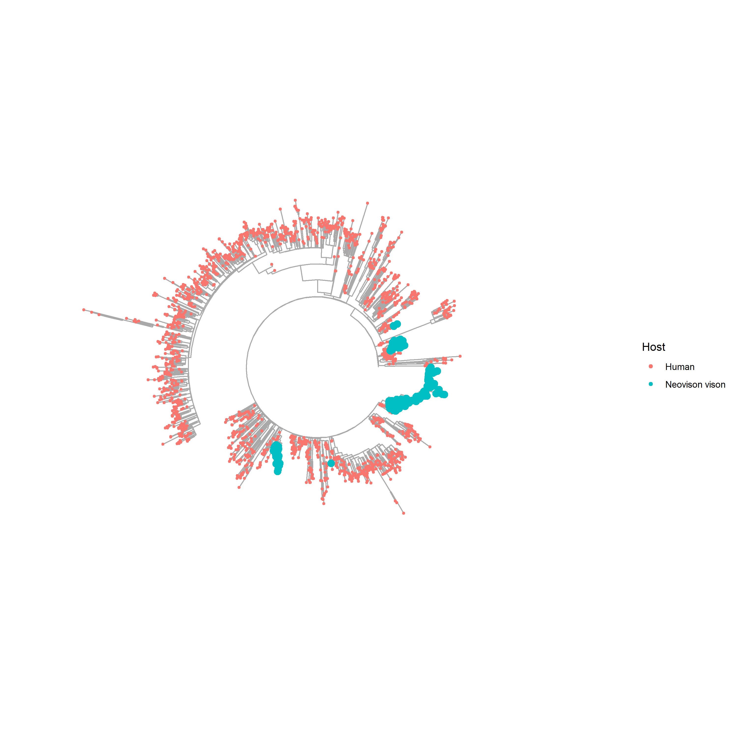
Mink + human (n=3219)

Slide 5
Mink + human (n=2213)

Slide 6
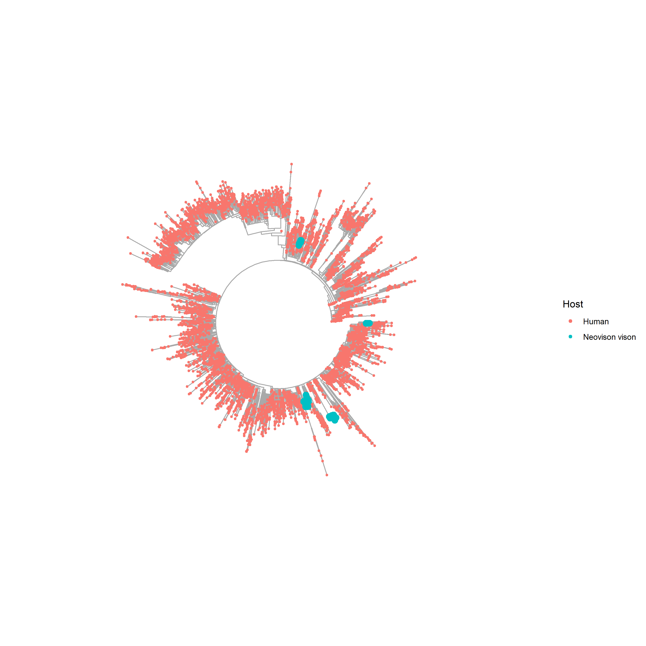
Mink + human (n=6726)

Slide 7
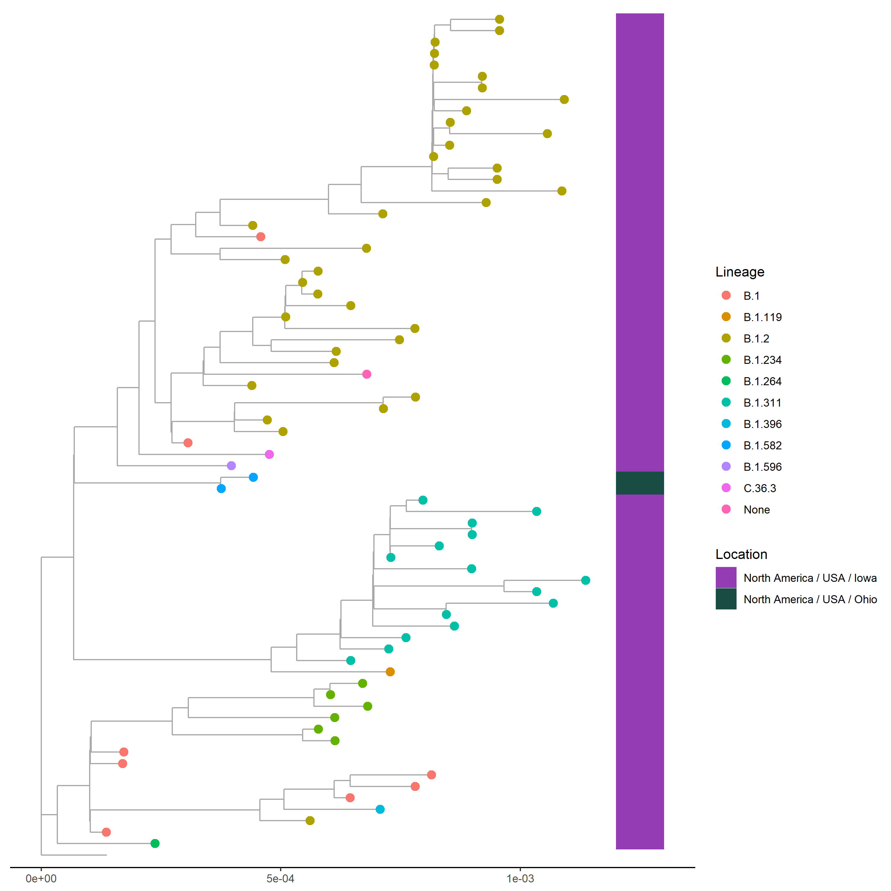
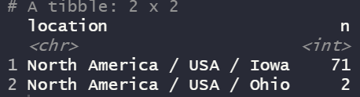
Deer (n = 73)

Slide 8
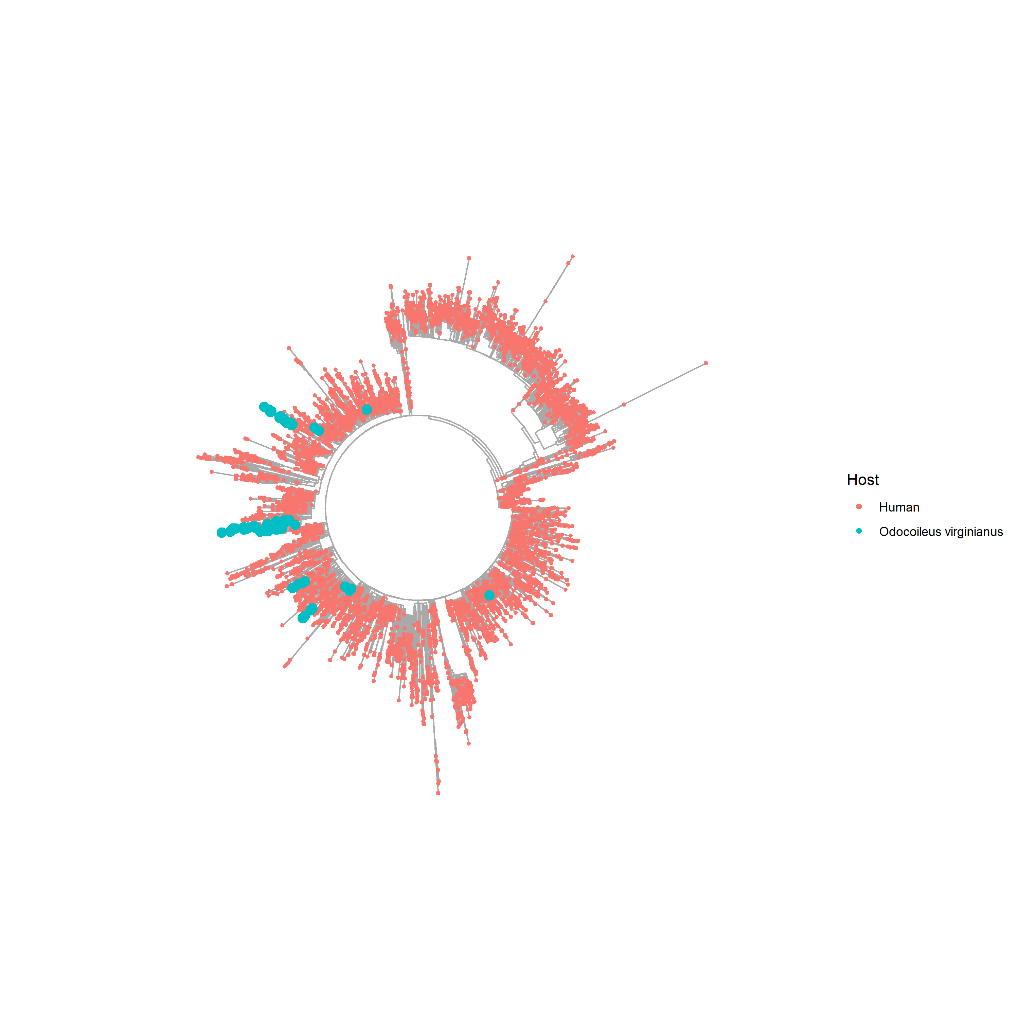
Deer + human (n = 6670)
At least 9 spillover events

Slide 9
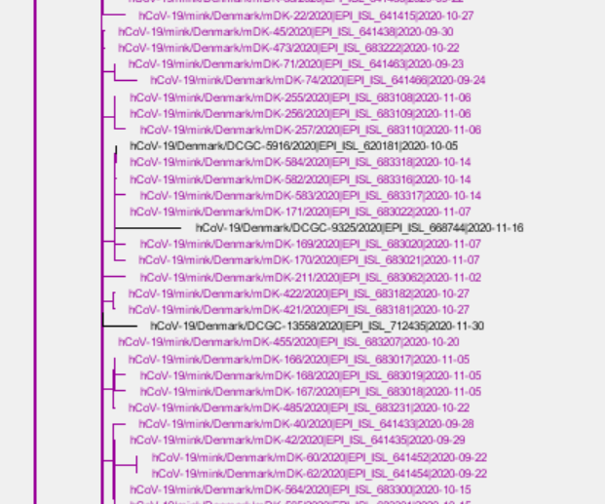
Spillovers back into humans (Denmark)

Slide 10
Multiple spillover events in minks and deer
Animal | Country | Total no. of isolates | No. of spillover events | Clusters with > 10 isolates | No. of isolates | Time span (days)
Mink | Denmark | 339 | 6 | D1 | 331 | 155
 | Netherlands | 264 | 5 | N1 | 182 | 193
 |  |  |  | N2 | 12 | 45
 |  |  |  | N3 | 33 | 95
 |  |  |  | N5 | 34 | 105
 | USA | 125 | 5 | US2 | 54 | 20
 |  |  |  | US3 | 10 | 11
 |  |  |  | US4 | 44 | 26
 |  |  |  | US5 | 17 | 45
Deer | USA | 73 | 12 | U7 | 22 | 58
 |  |  |  | U8 | 13 | 62
 |  |  |  | U10 | 16 | 35
D

Slide 11
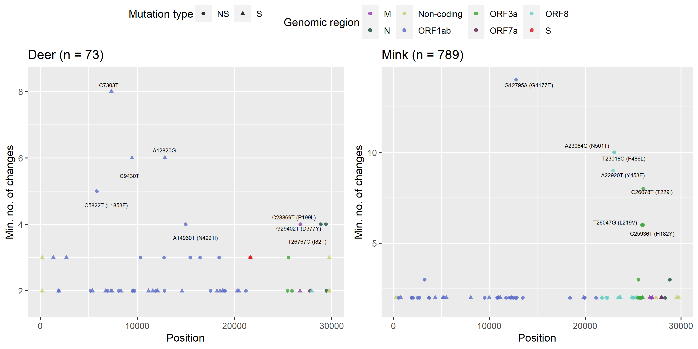
Homoplasies can inform on putatively adaptive mutations

Slide 12
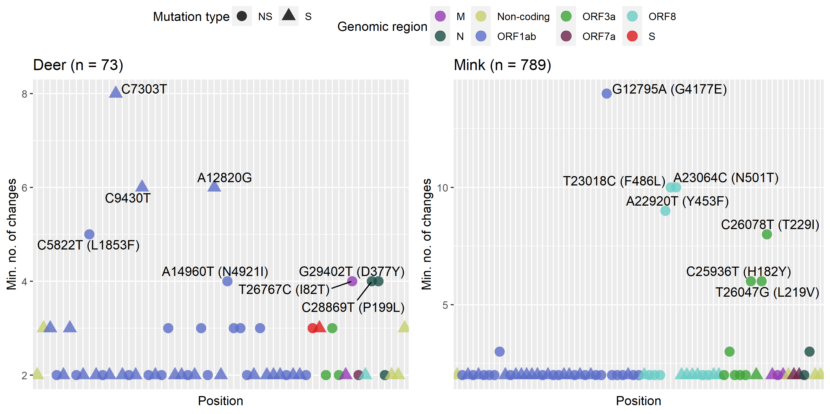
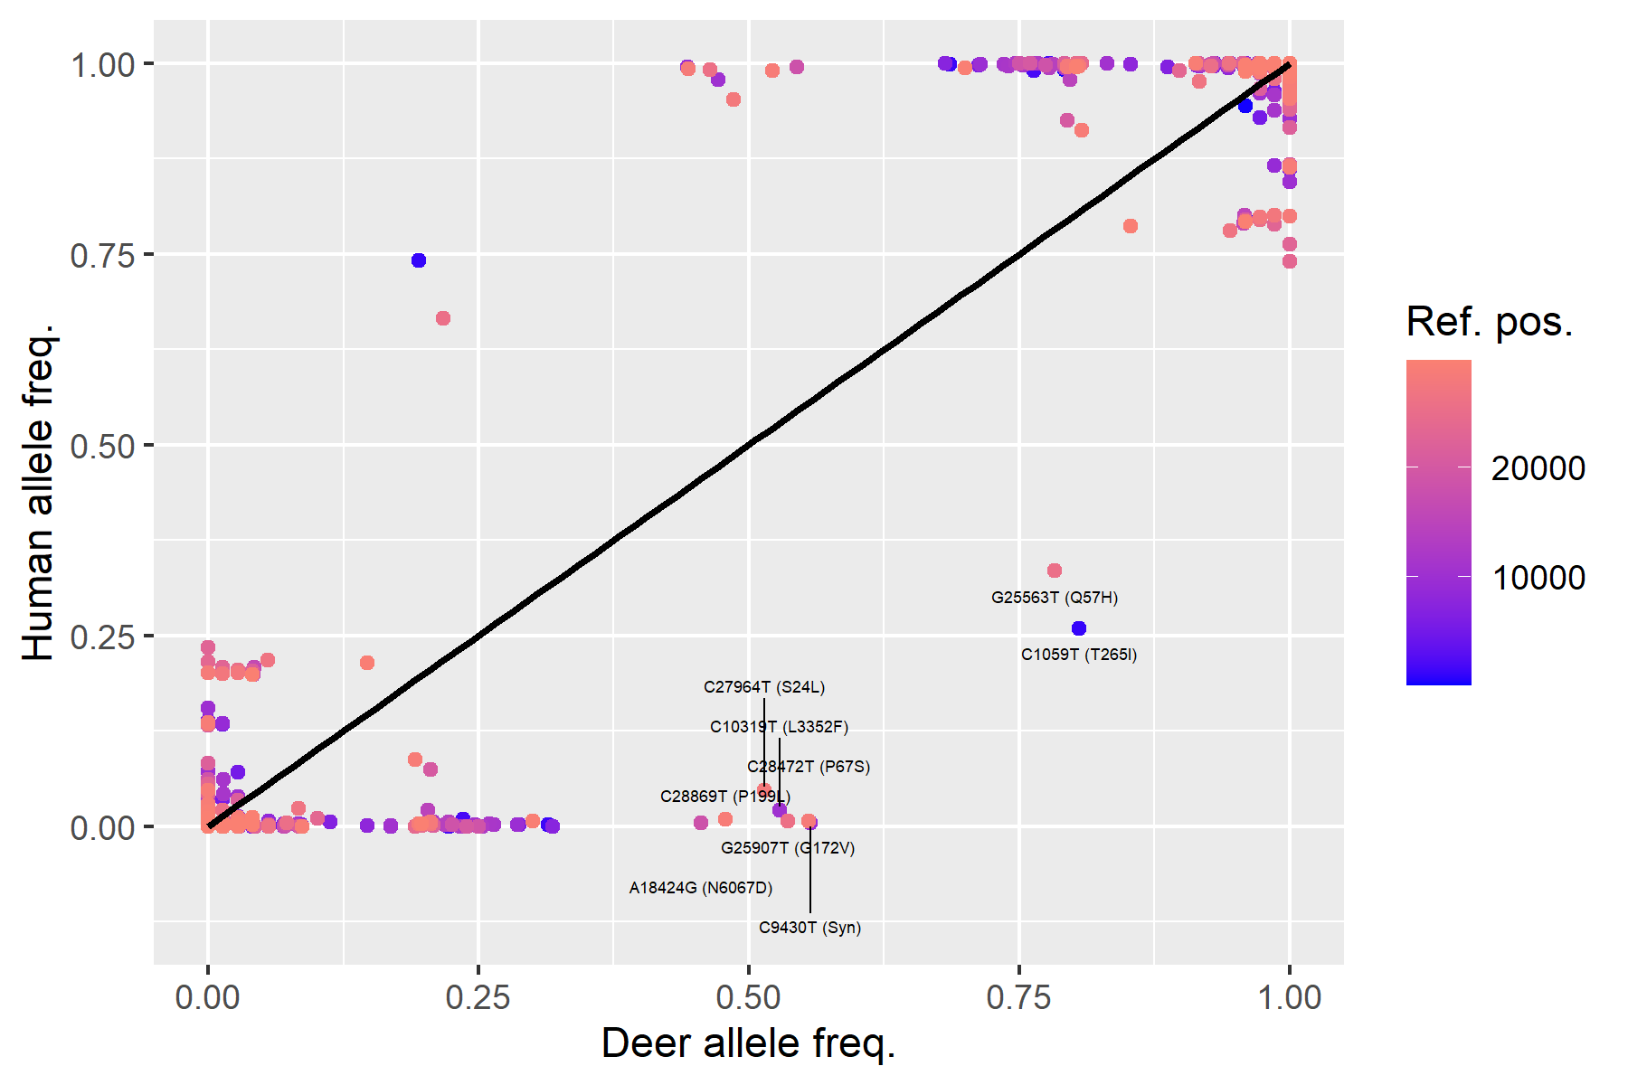
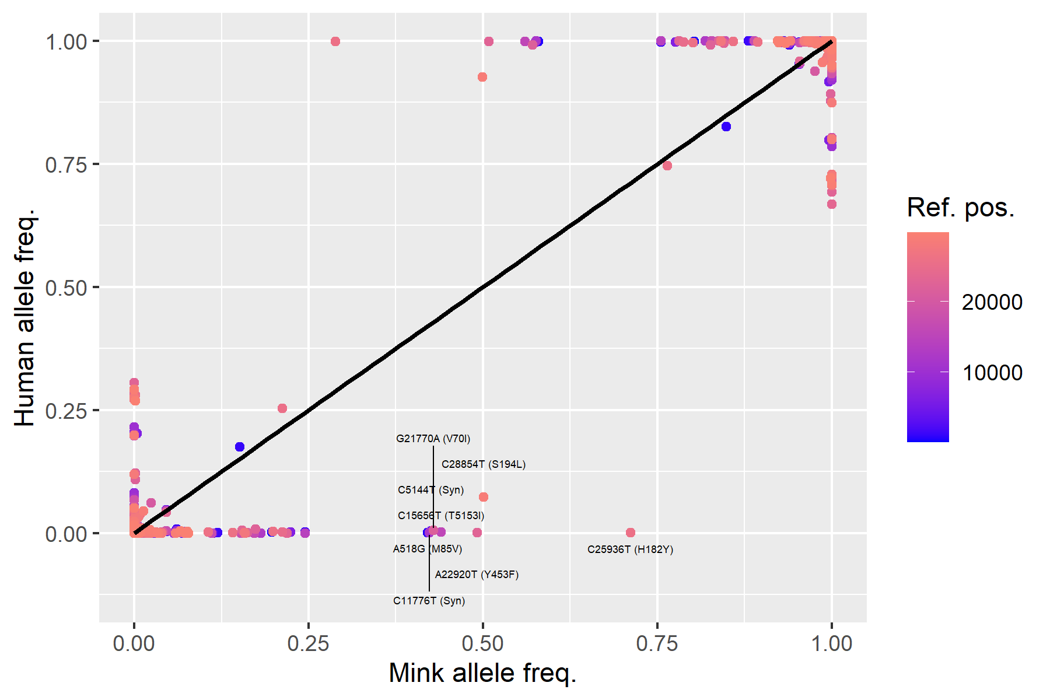

Slide 13
Calculating Min. No. of changes
If the descendant nodes of an internal node share nucleotides, then the shared nucleotides will be assigned to current internal node
If the descendant nodes of an internal node don't share any nucleotides, then the nucleotides of each descendant node will be combined into a set and assigned to the current internal node
The minimum number of changes that are necessary to explain the pattern of nucleotides at the tips of the phylogeny, is equal to the number of times Rule 2 was true (https://github.com/JosephCrispell/homoplasyFinder/wiki/Calculating-consistency-index)

Slide 14
Independent spillover events lead to artefactual homoplasies
T
T,G
G
T
T,G
G

Slide 15
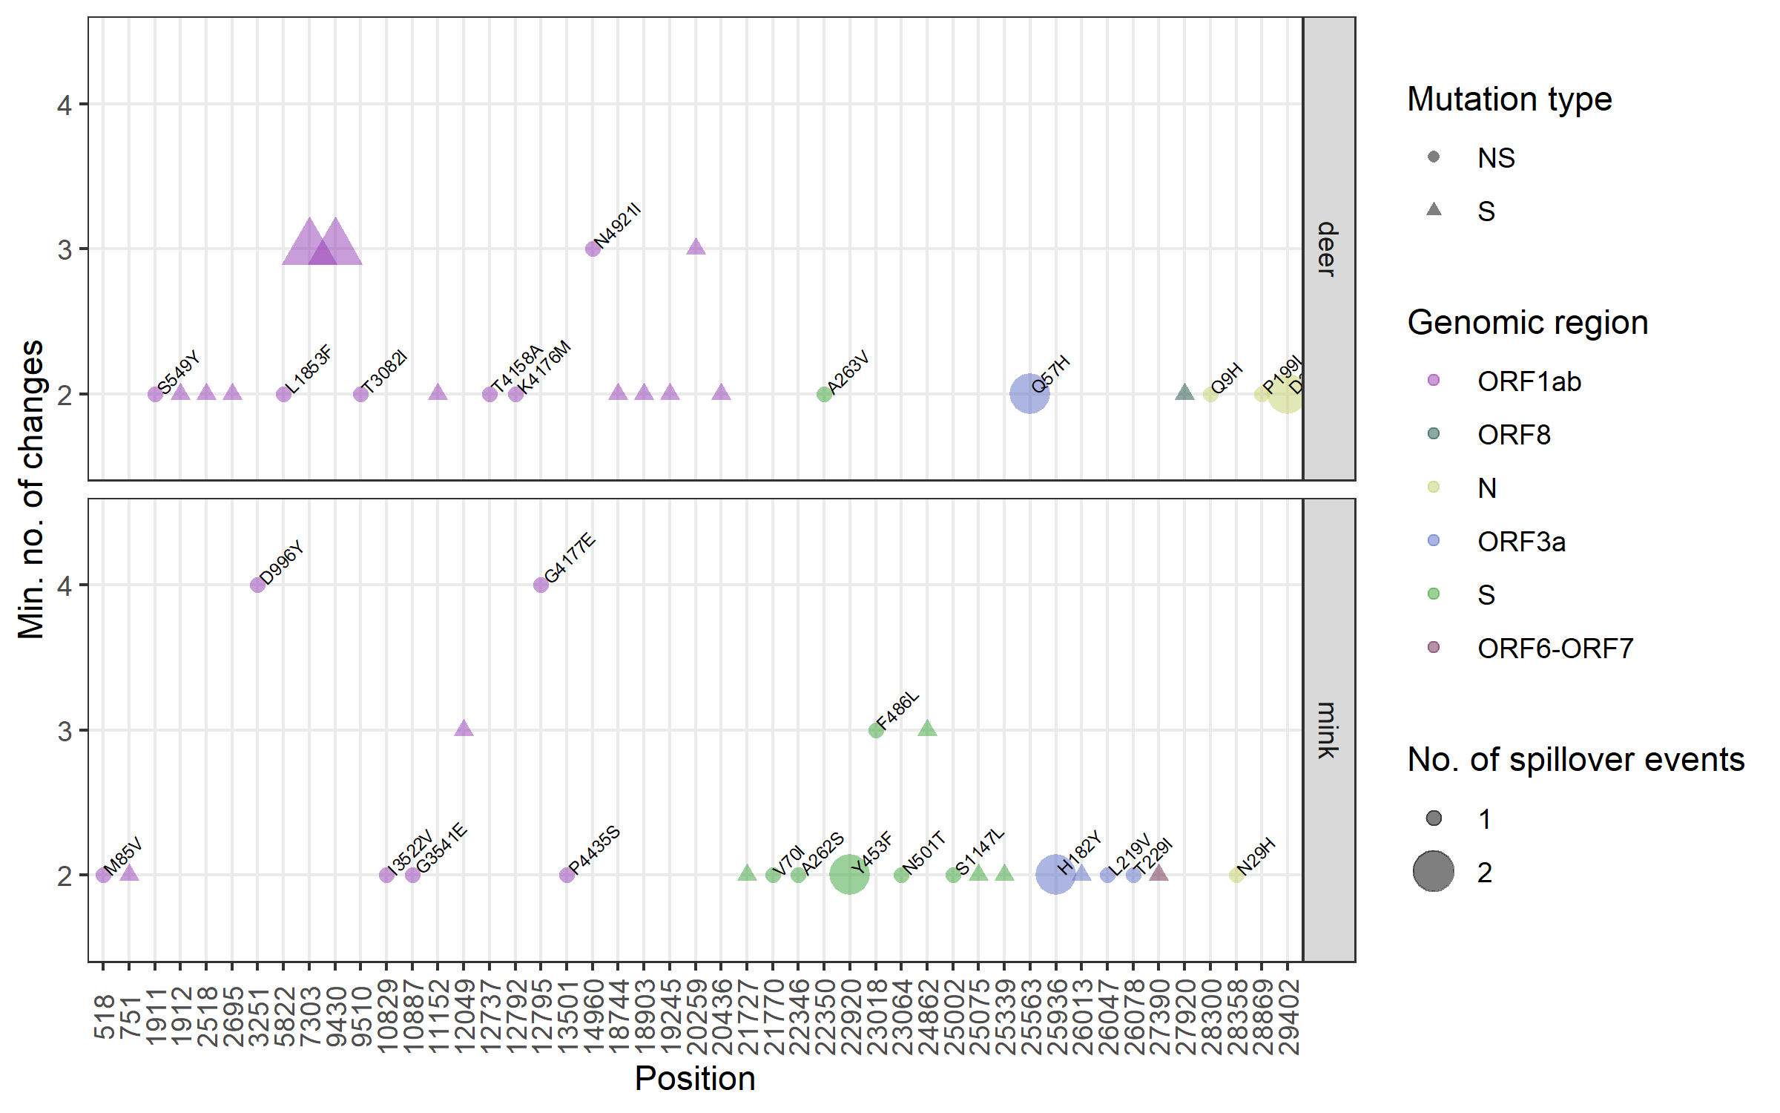
Homoplasy analysis of independent clusters suggest Weak adaptive signal

Slide 16
Allele frequency changes can inform on adaptation

Slide 17
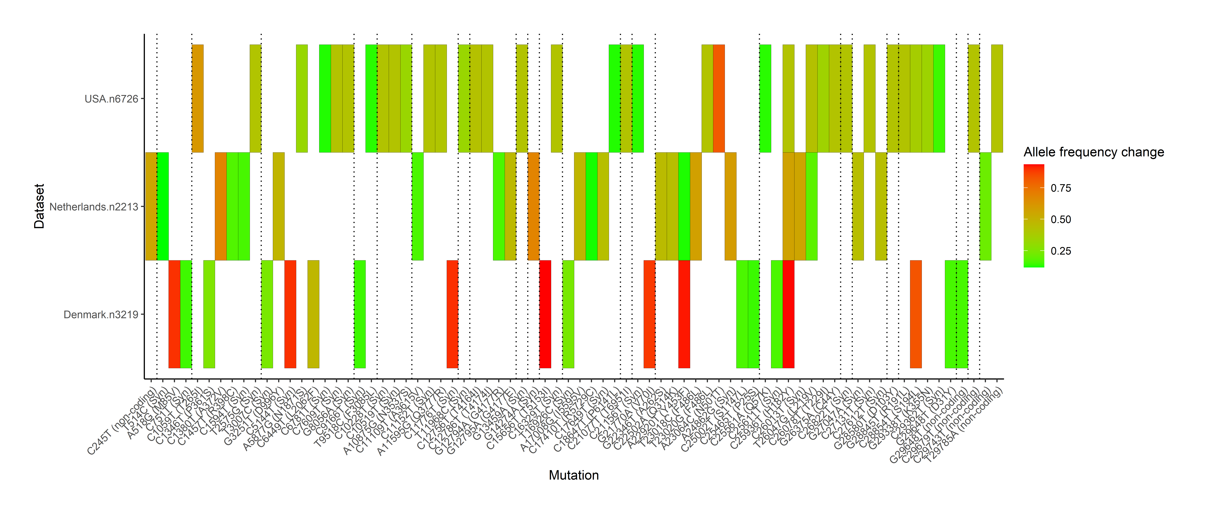
Putatively adaptive alleles
Alleles critical for transmission

Slide 18
Putatively adaptive alelles not consistent across countries

Slide 19
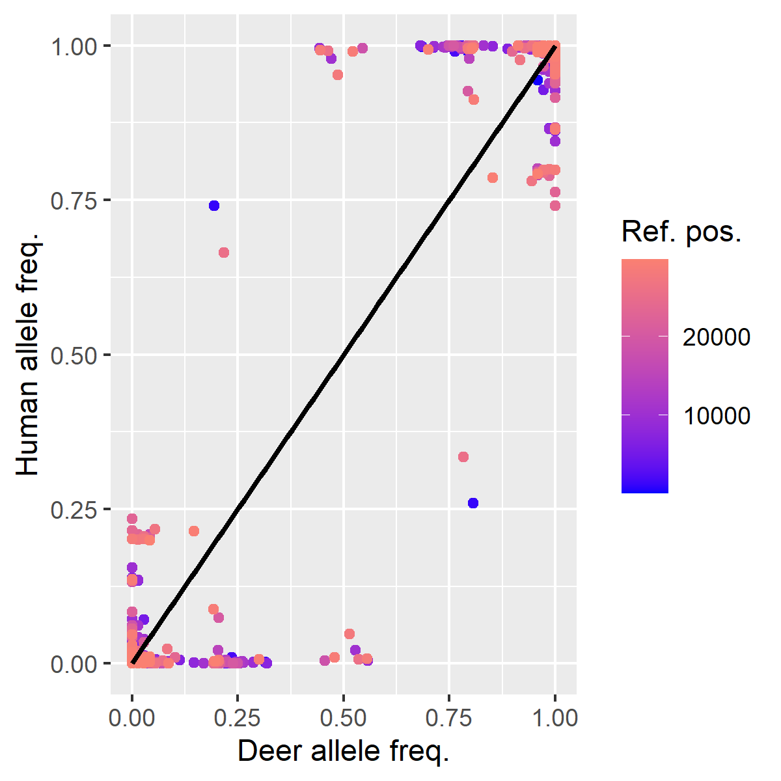

Slide 20
S
ORF7a
3’UTR
NSP14
ORF3a
ORF7b
NSP9
M
NSP4
NSP6
NSP12
5’UTR
NSP3a
NSP13
ORF8-N
N

Slide 21
5’UTR
NSP2
NSP3a
NSP9
NSP14
S
ORF3a
N
3’UTR
NSP4
NSP6
NSP12a
ORF8
NSP5a
NSP7
NSP8
NSP15a

Slide 22
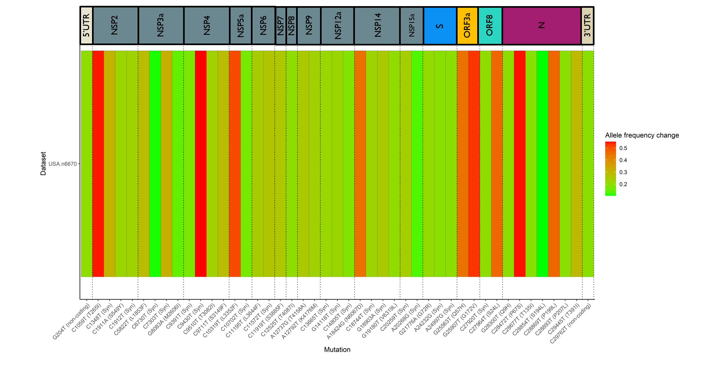

Slide 23
Different human backgrounds for different Analyses
Analysis | Human | Animal
Allele frequency changes | 10 from each lineage within same country | Isolates within same country
Homoplasy | Isolates within same cluster | Isolates within same cluster
Mutation rate change | Human isolates within same lineage, country and time | All isolates
 | Human isolates within same lineage, country and time | Isolates in cluster
Identifying pre-jump mutations | Isolates with same lineage and country

Slide 24
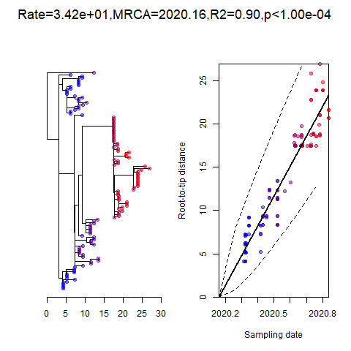
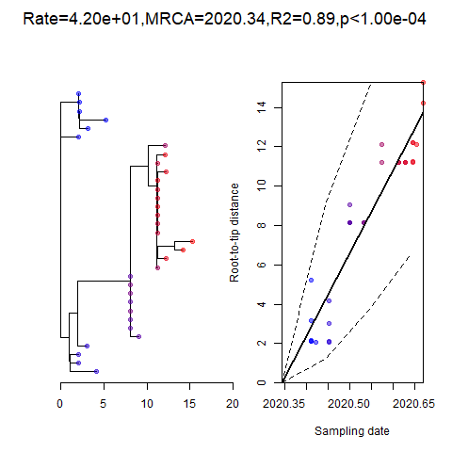
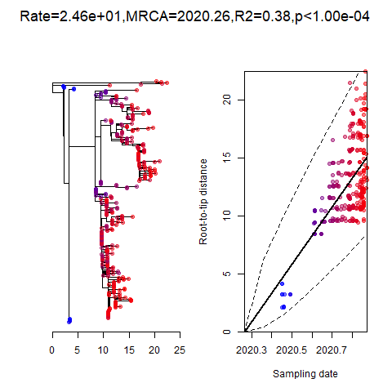
Temporal signal in three mink clusters
N1 cluster
N3 cluster
D1 cluster

Slide 25
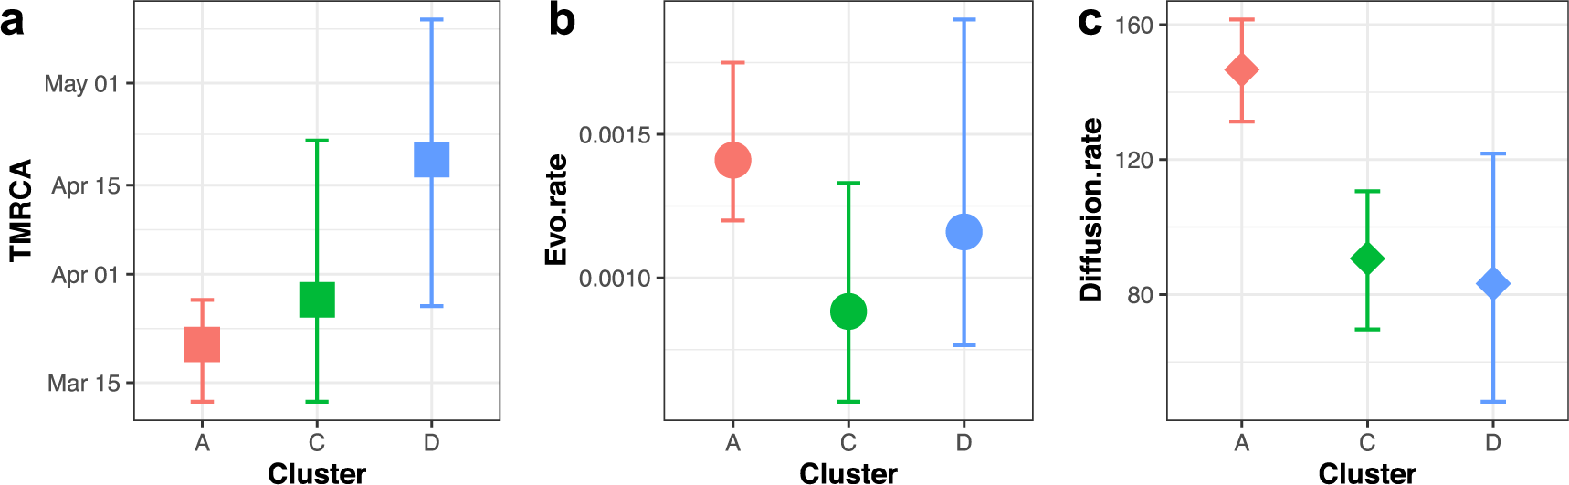
Results from dutch mink paper

Slide 26
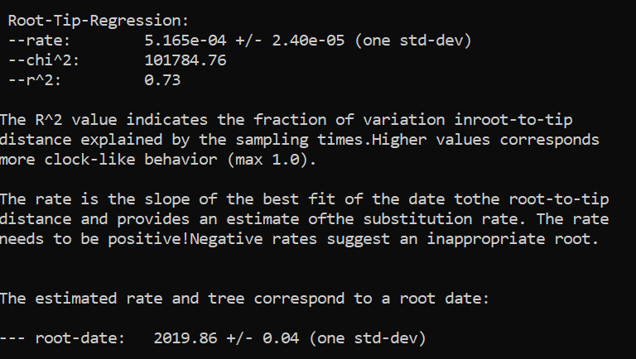
Netherlands human + mink dedup unambiguous
2019-11-10 (2019-10-27 - 2019-11-25)

Slide 27
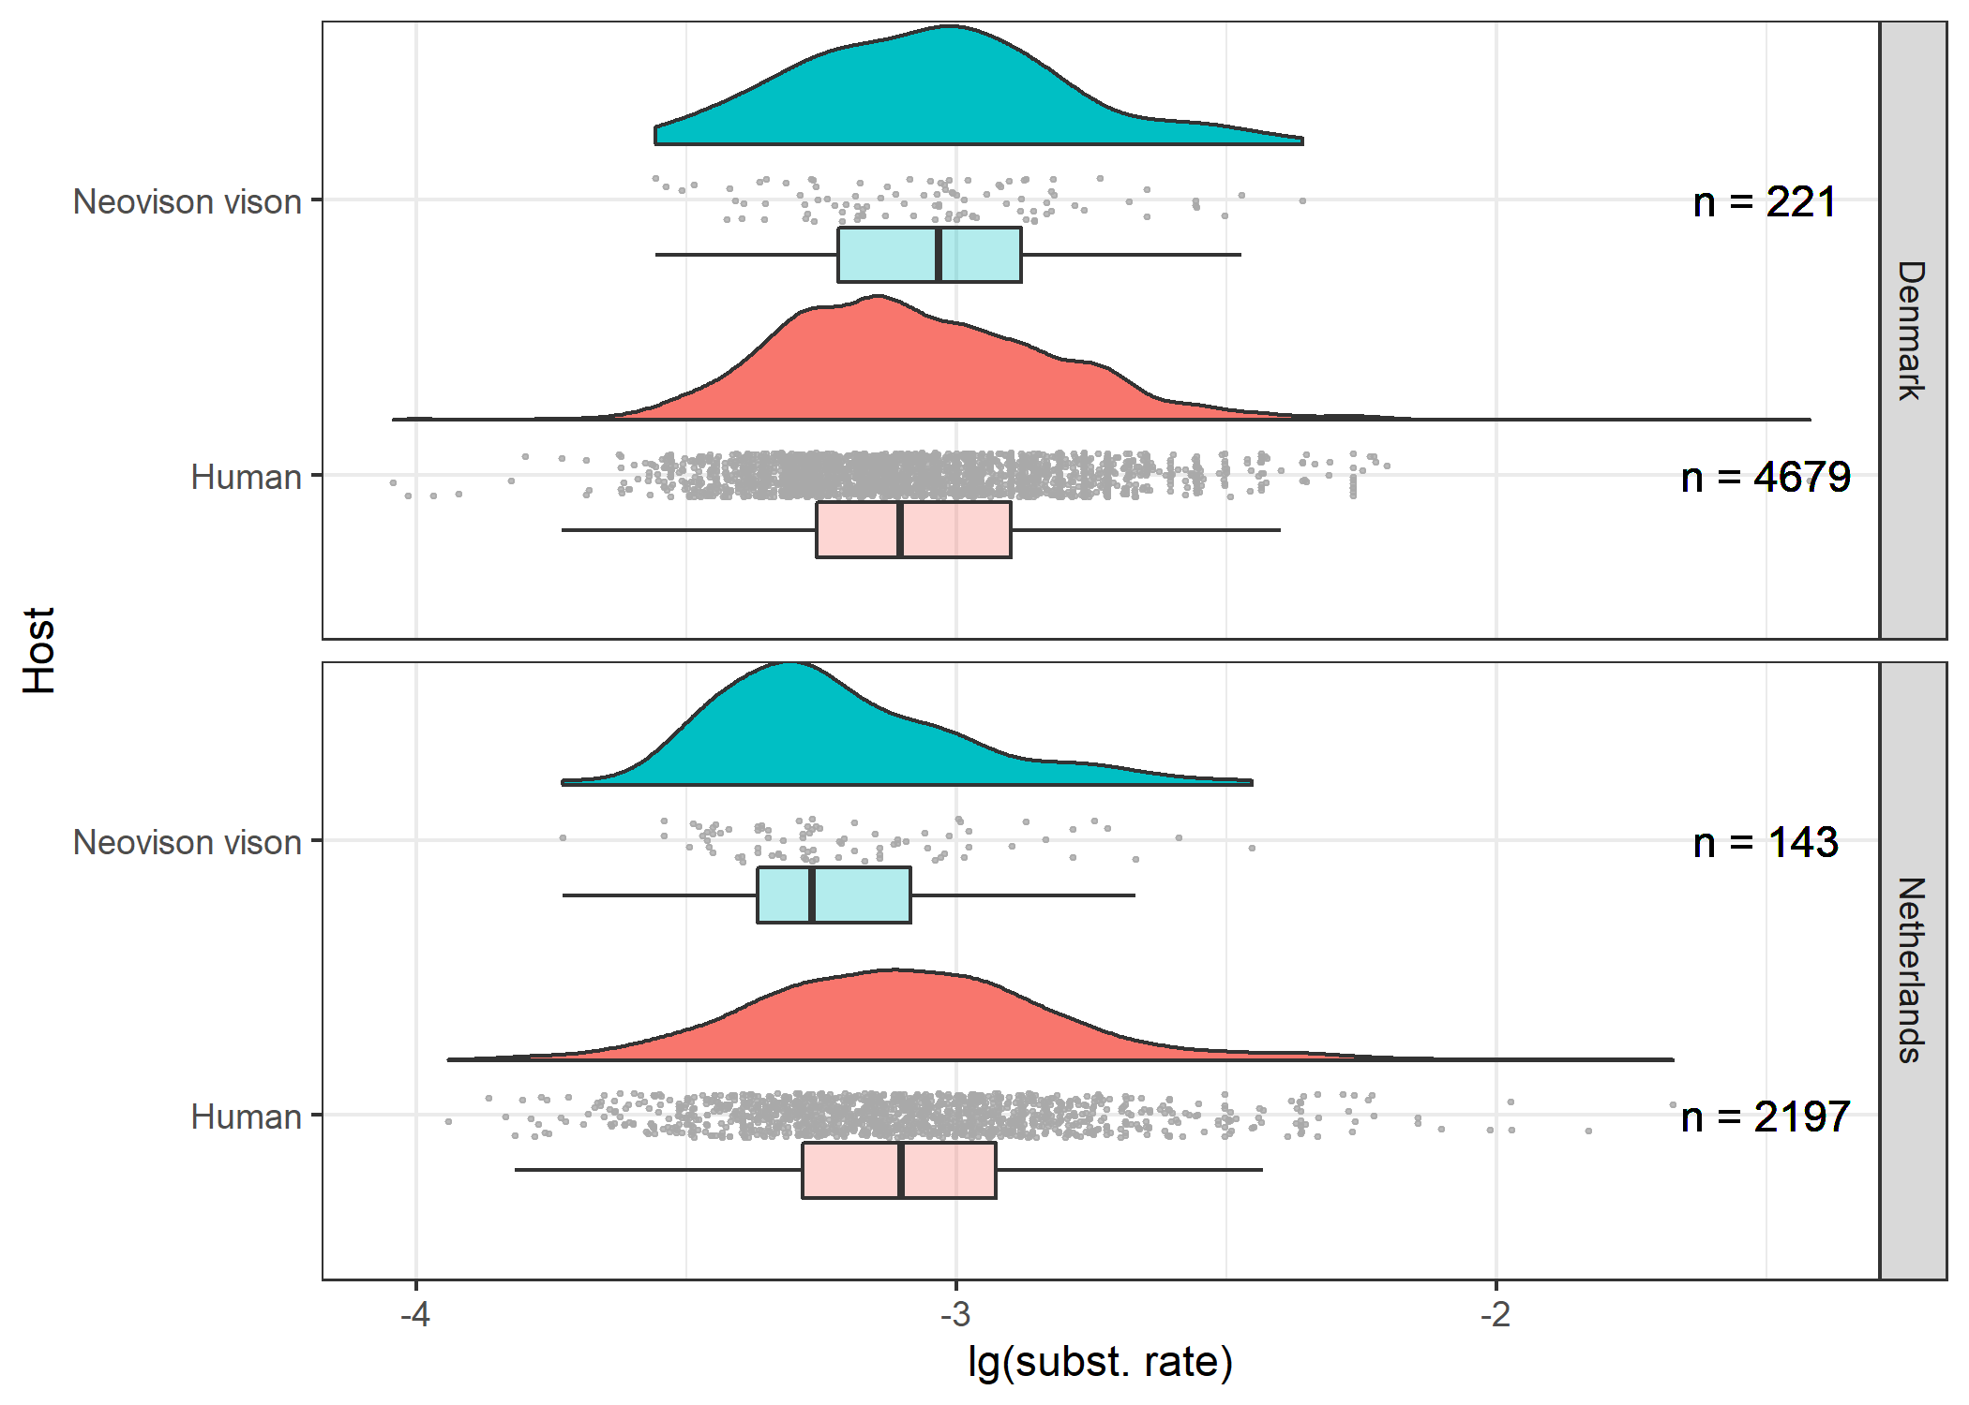
No detectable change to substitution rates

Slide 28
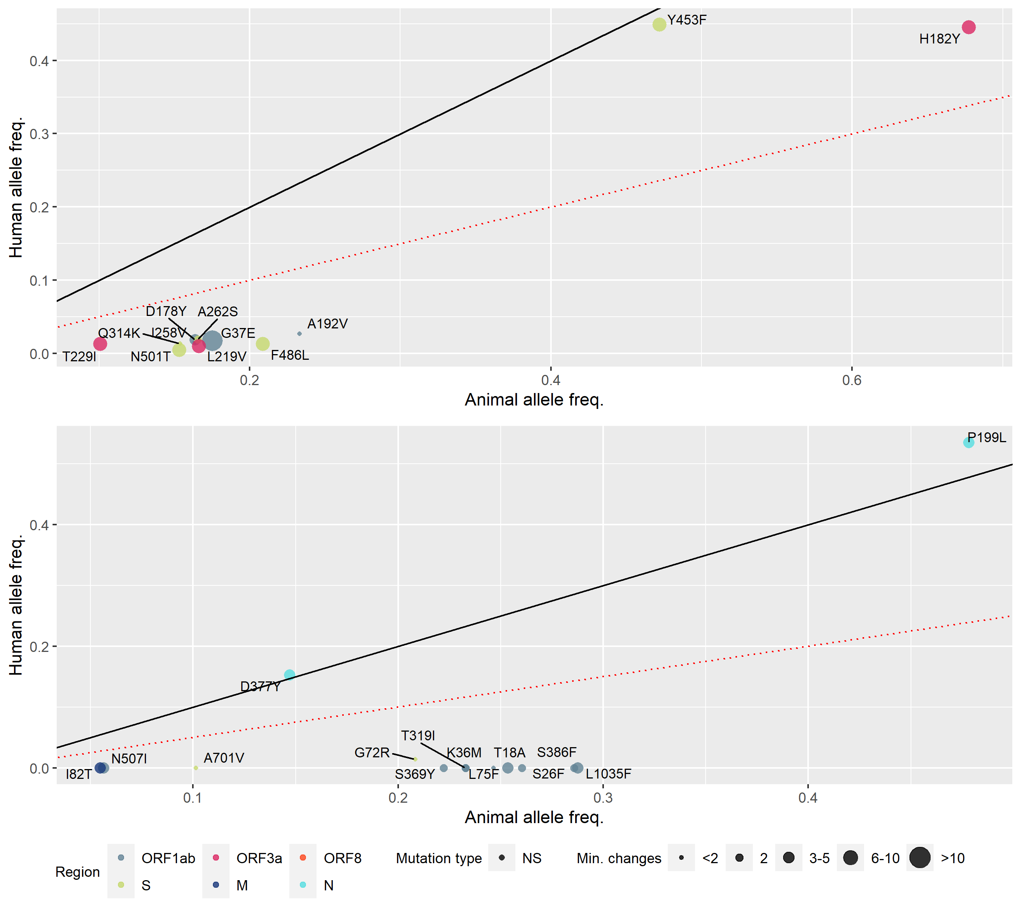
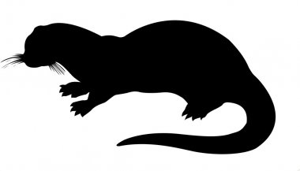
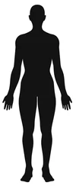
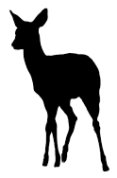
n = 711
n = 789
n = 72
n = 73

Slide 29
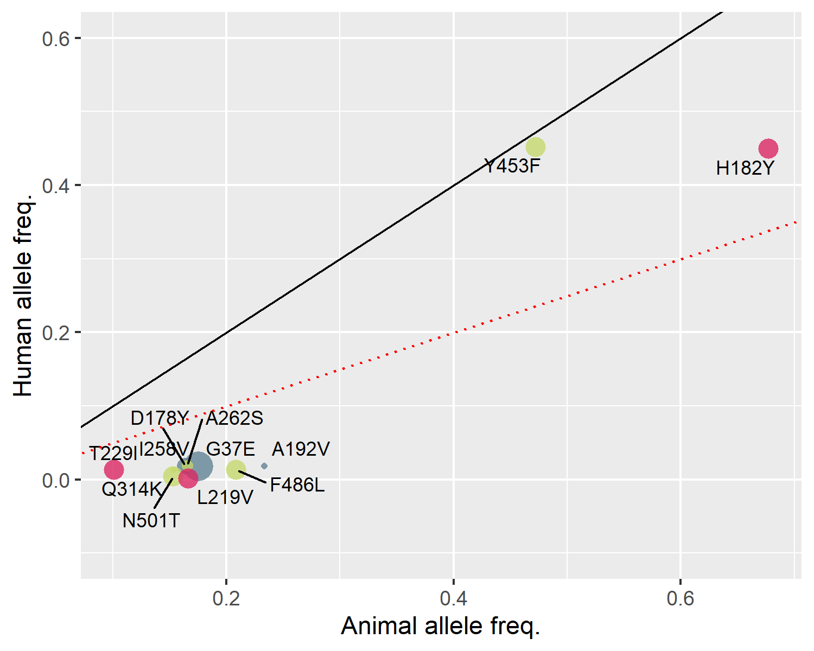
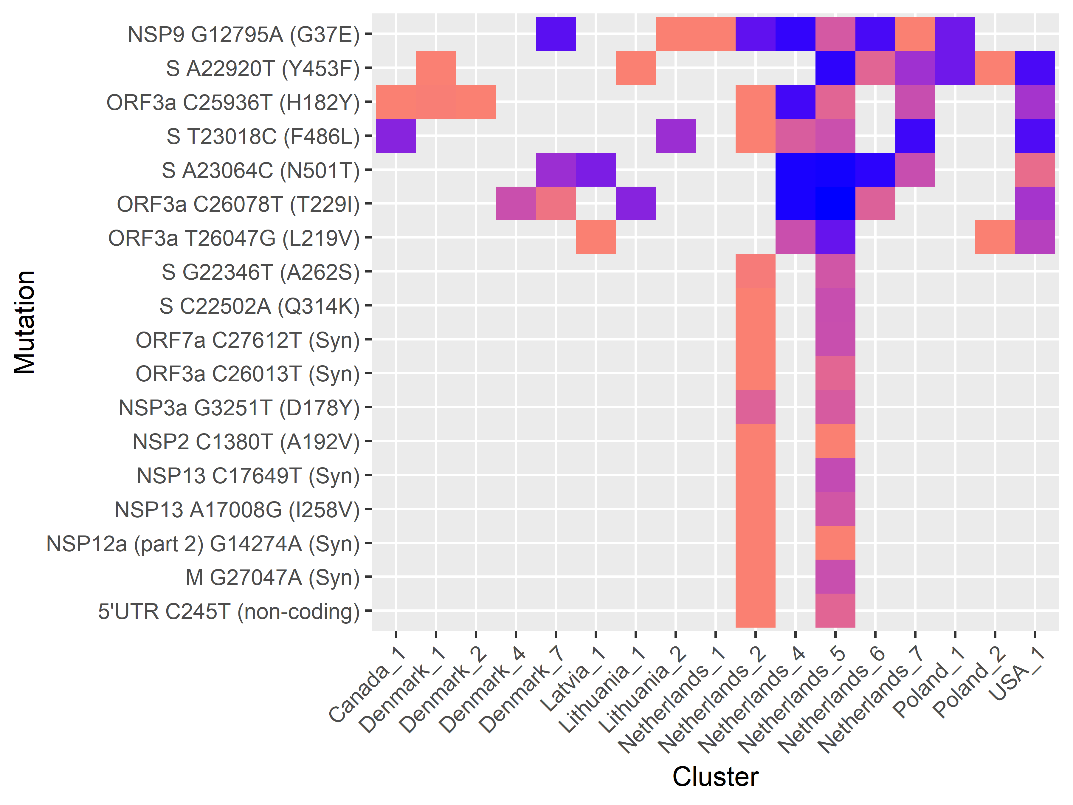
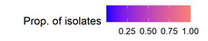
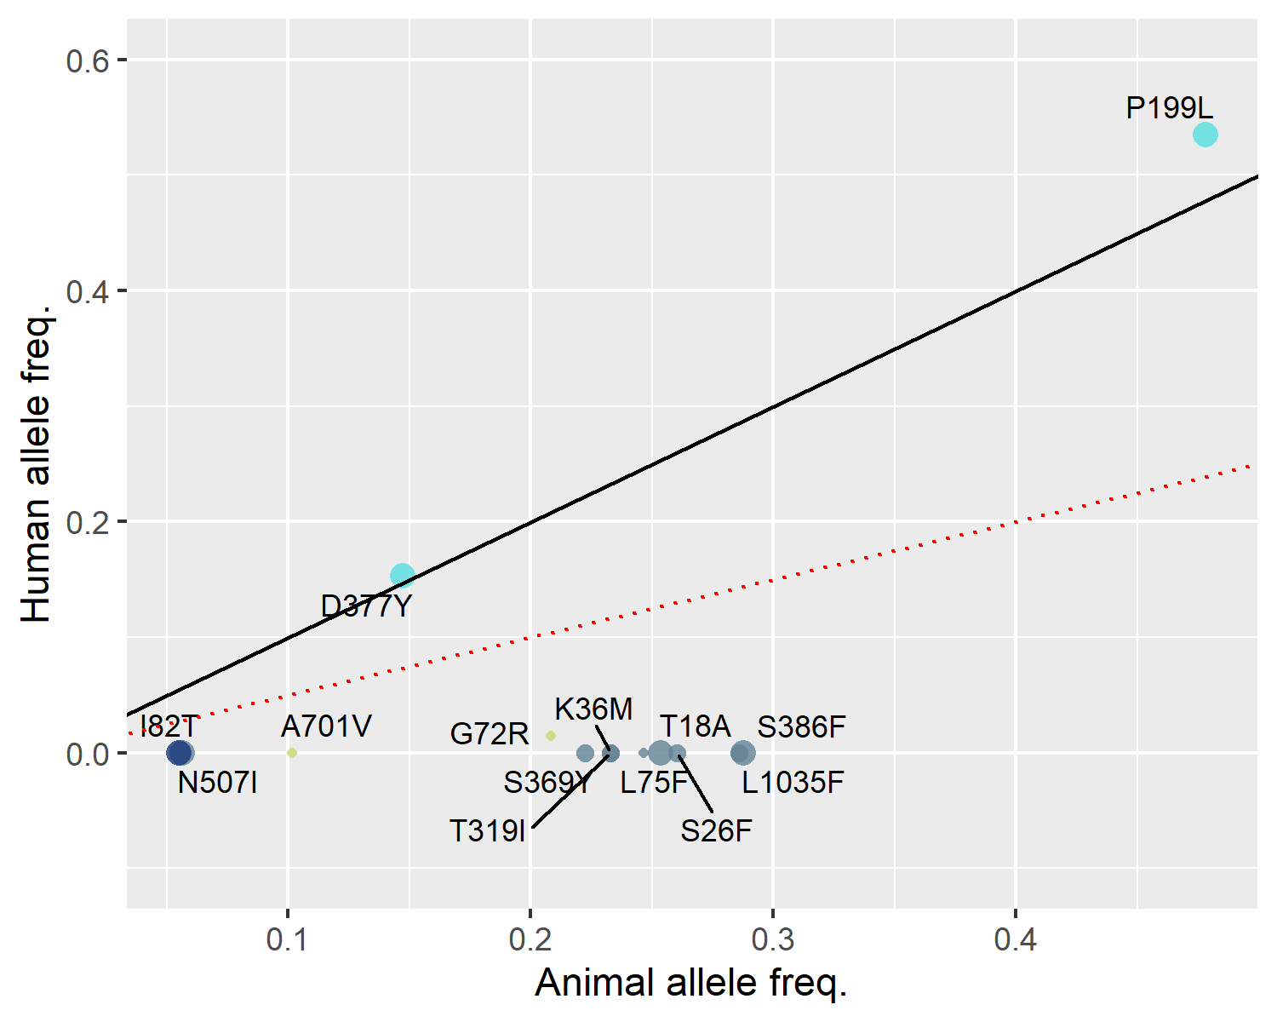
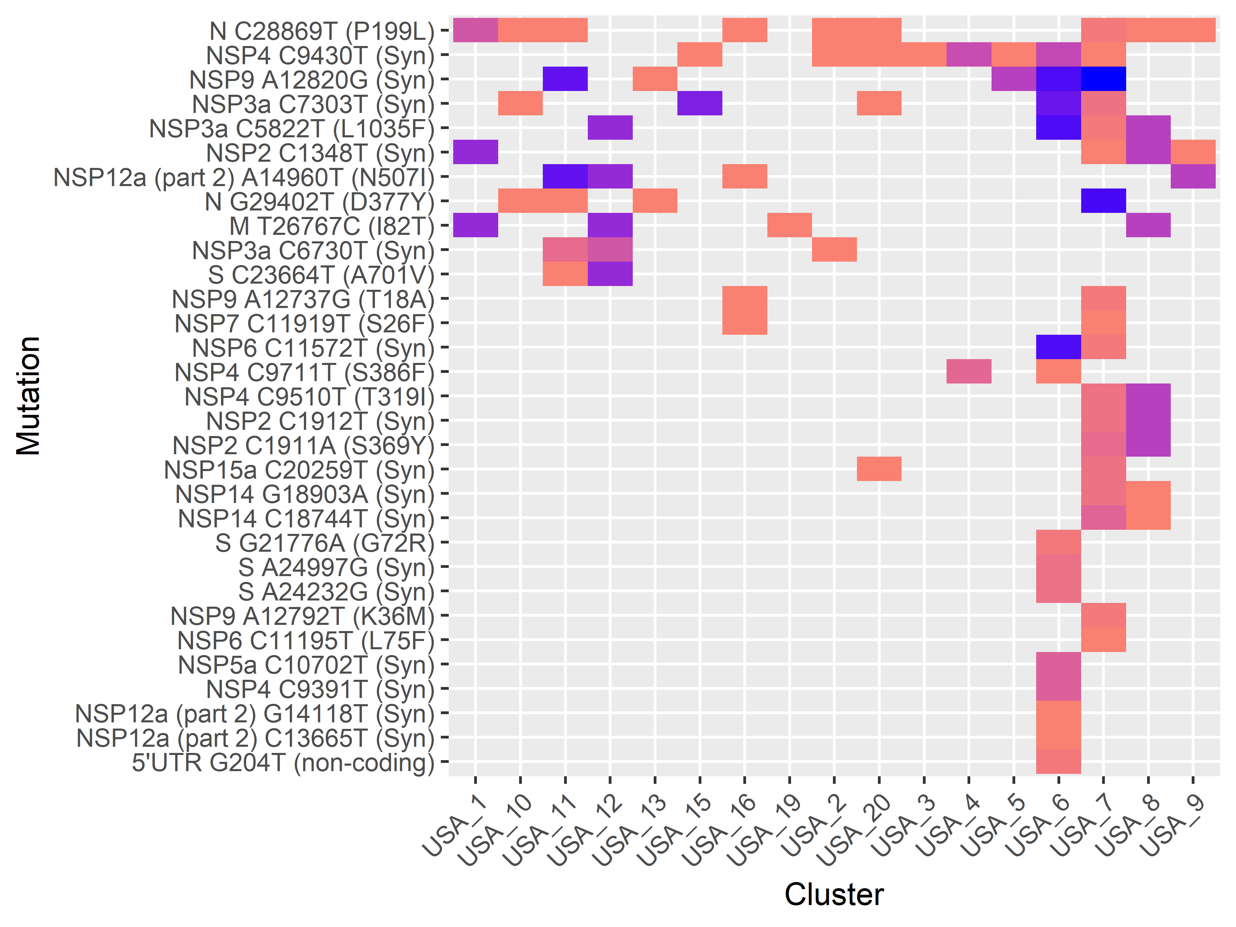
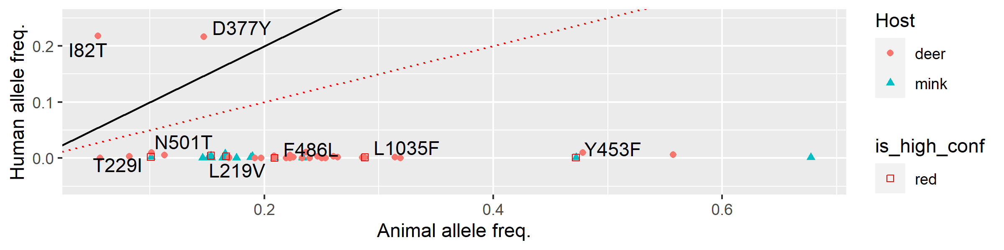
(a)
(c)
n = 789
n = 705
(b)
(d)
n = 72
n = 73
(e)

Slide 30
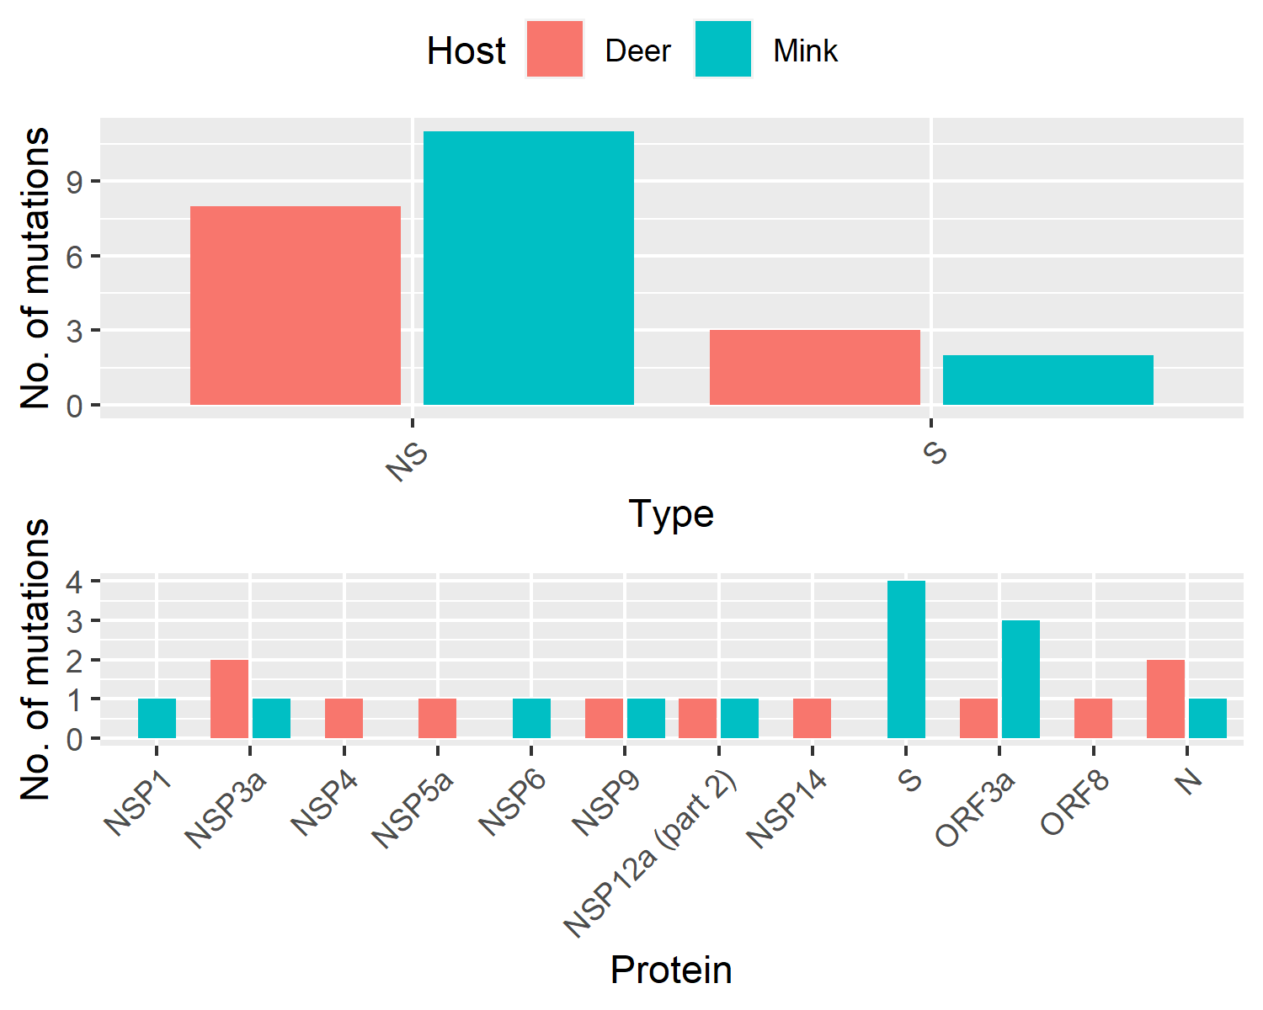
Mutation breakdown by host
> 3 min_changes OR human_allele_frequency < 0.1

Slide 31
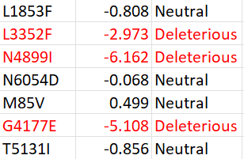
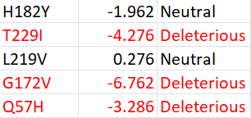
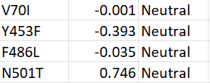
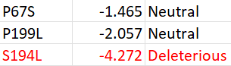
PROVEan: candidate host-adaptive mutations affect structure/function
ORF1ab
ORF3a
Spike
N501Y -0.090
Nucleocapsid

Slide 32
Transmission of sars-cov-2 from humans to animals and putative host adaptation

Slide 33
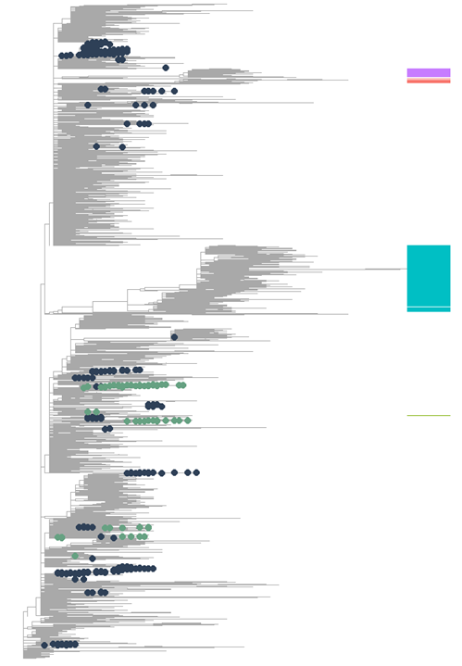
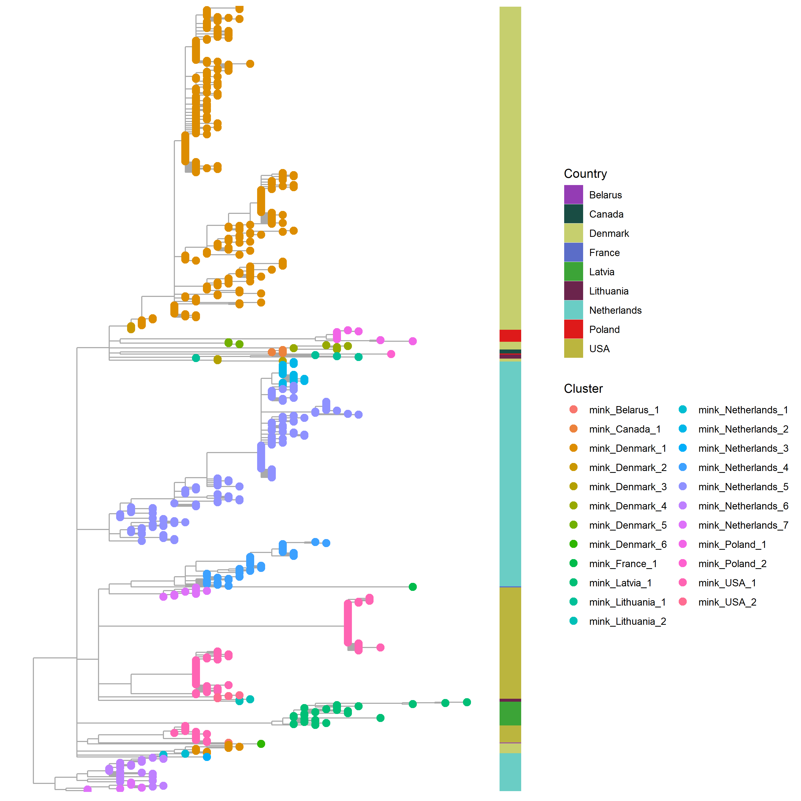
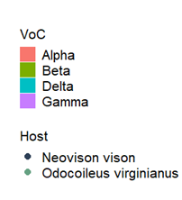

Slide 34
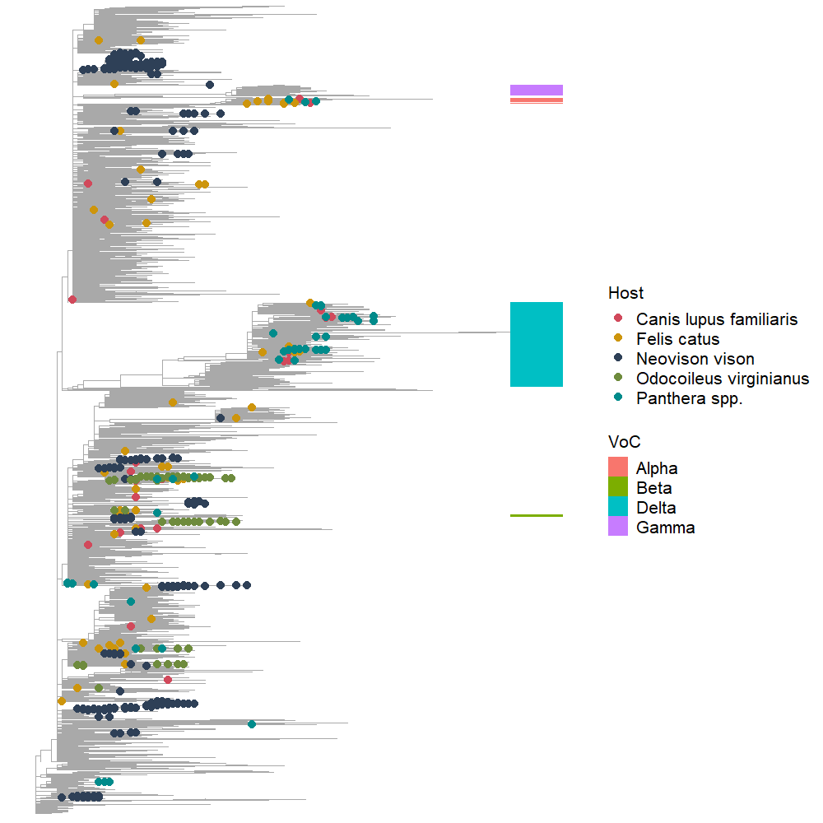
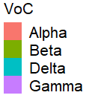
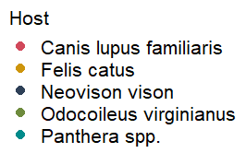
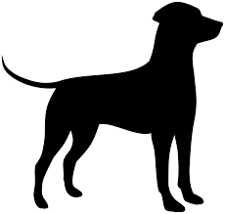



Slide 35
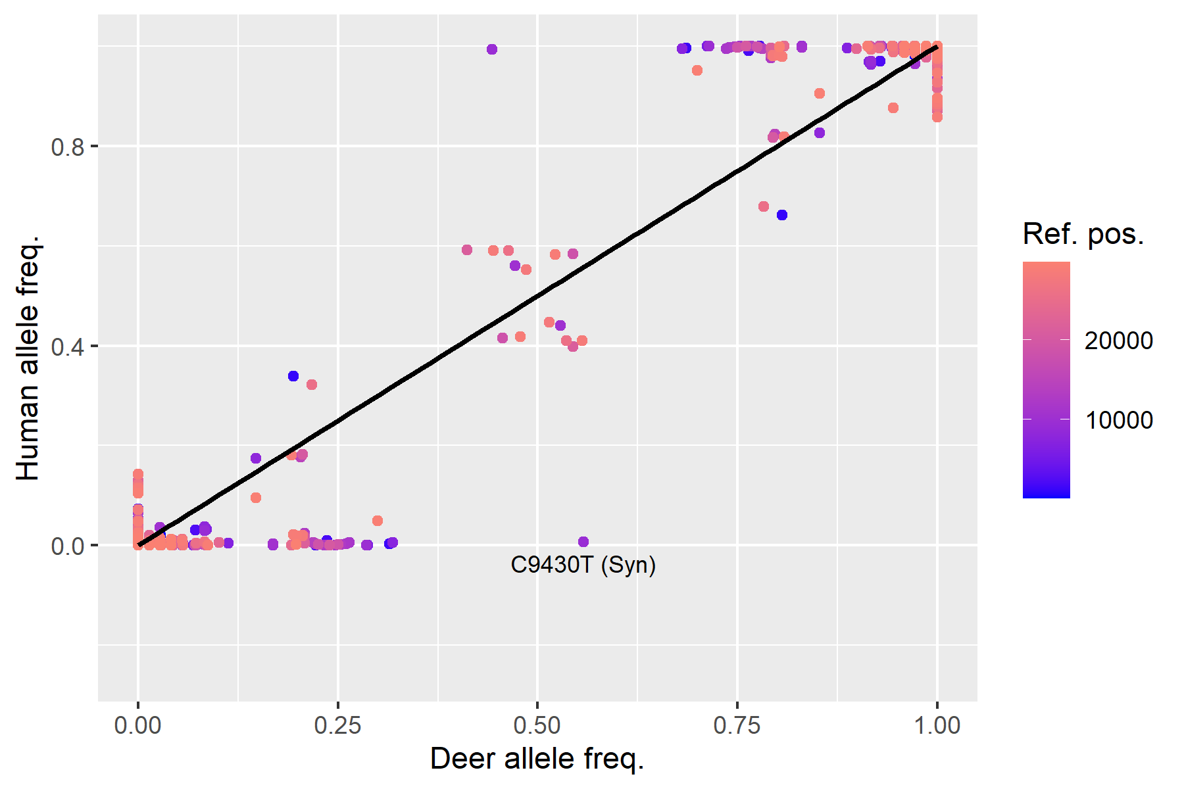
Sampling technique?
V1: 10 per lineage in USA, all-time
V2: Restricted to deer sampling range

Slide 36
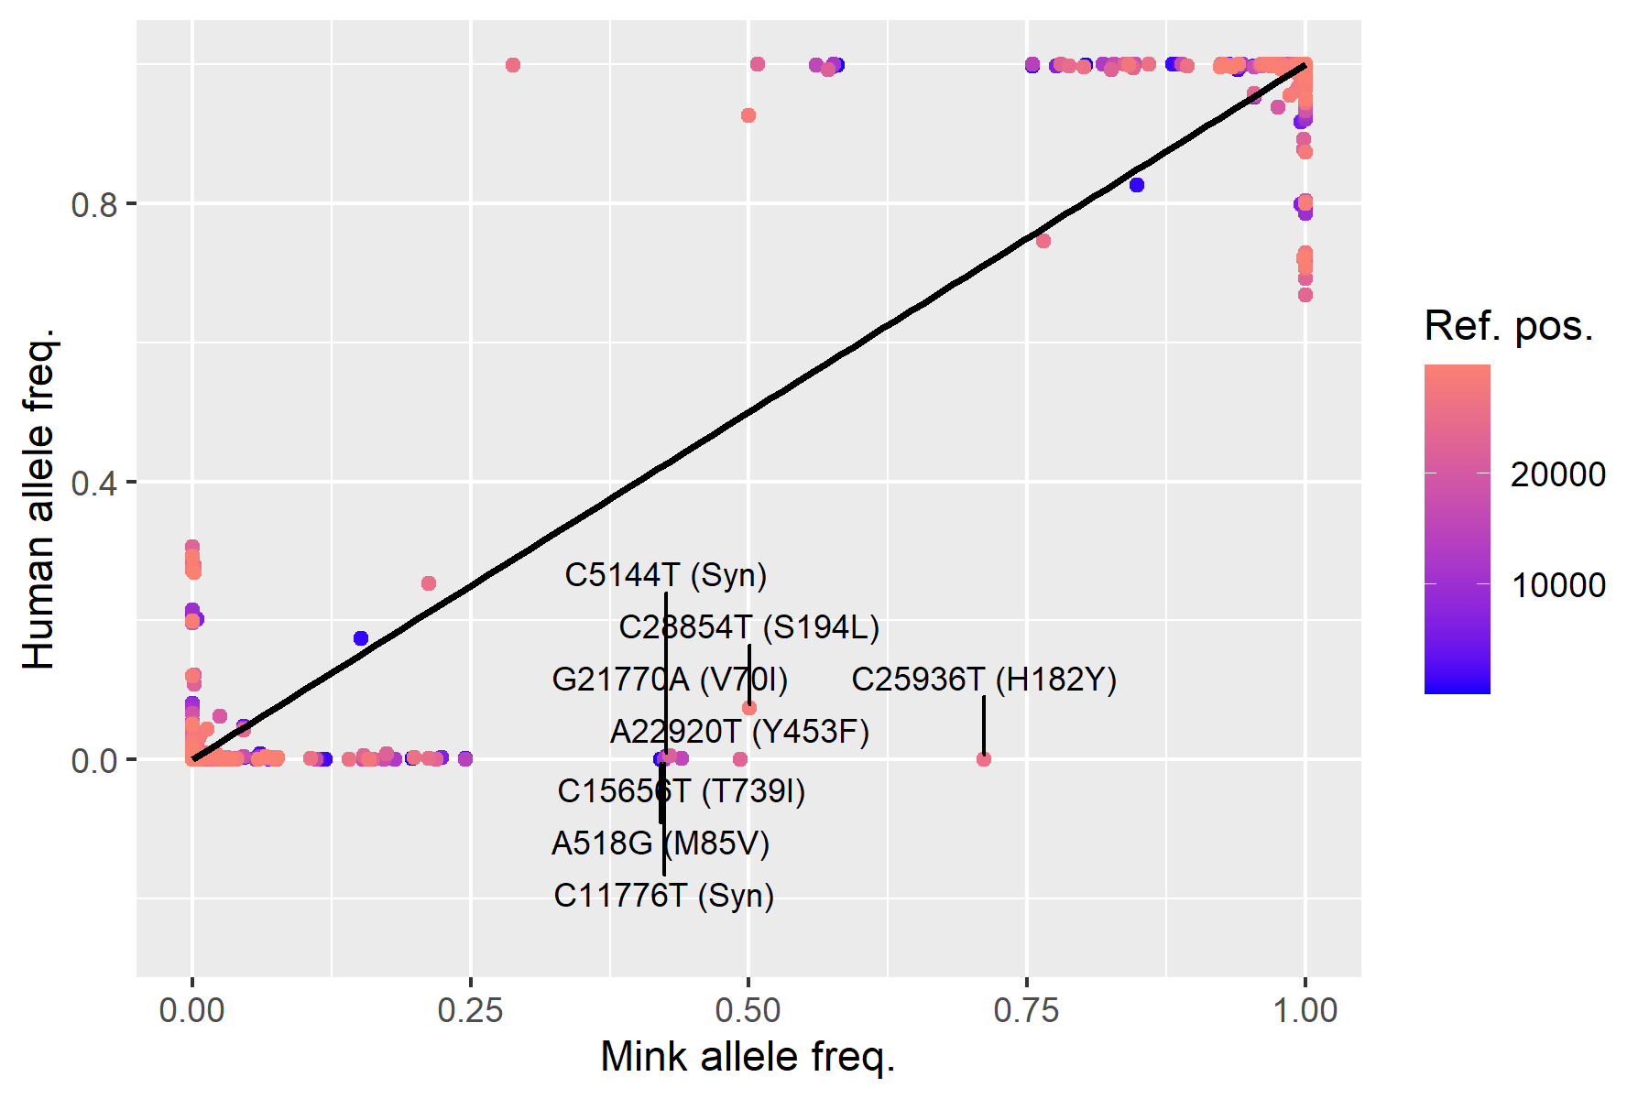
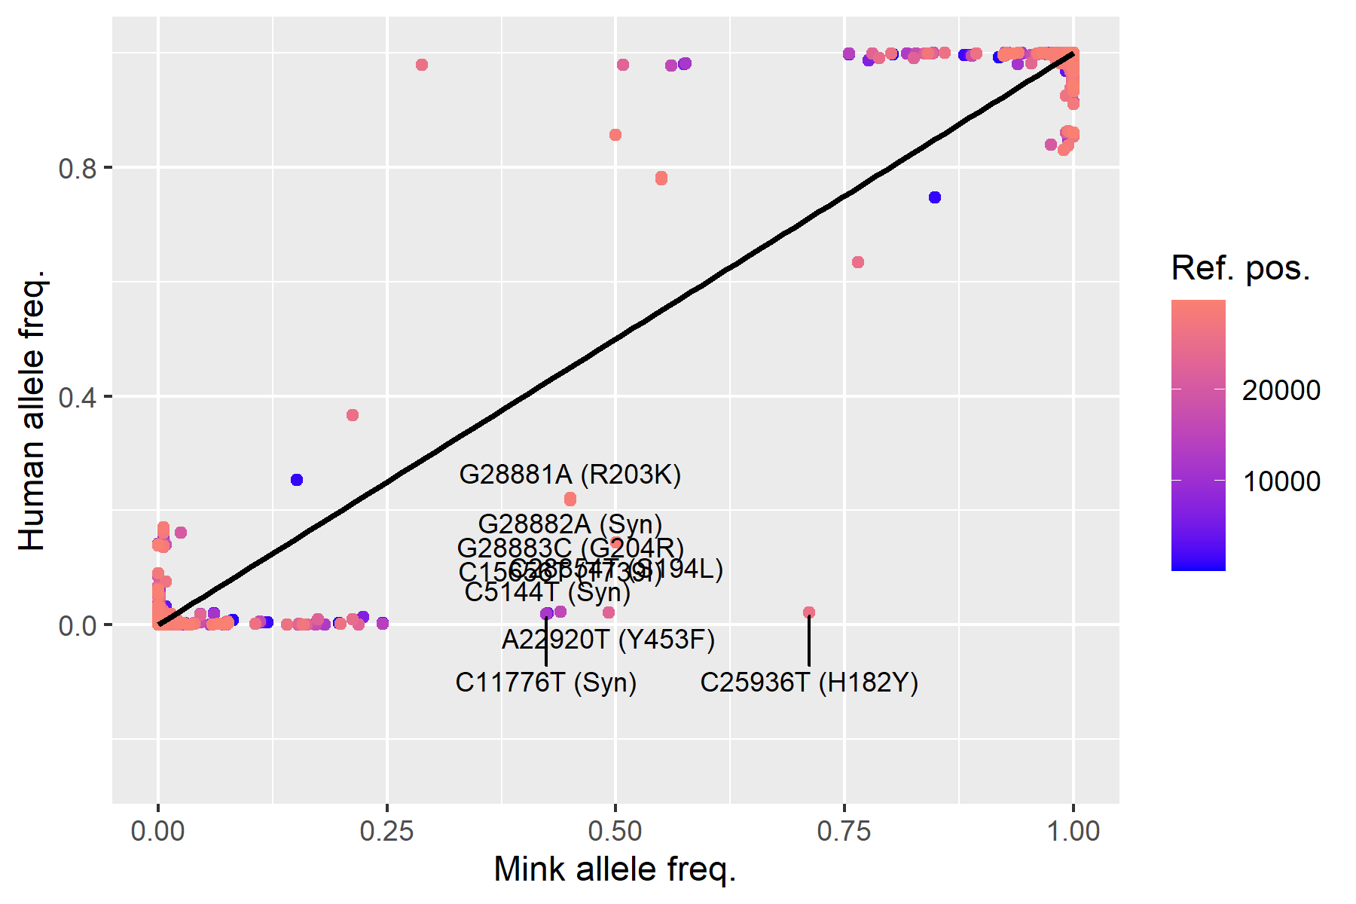
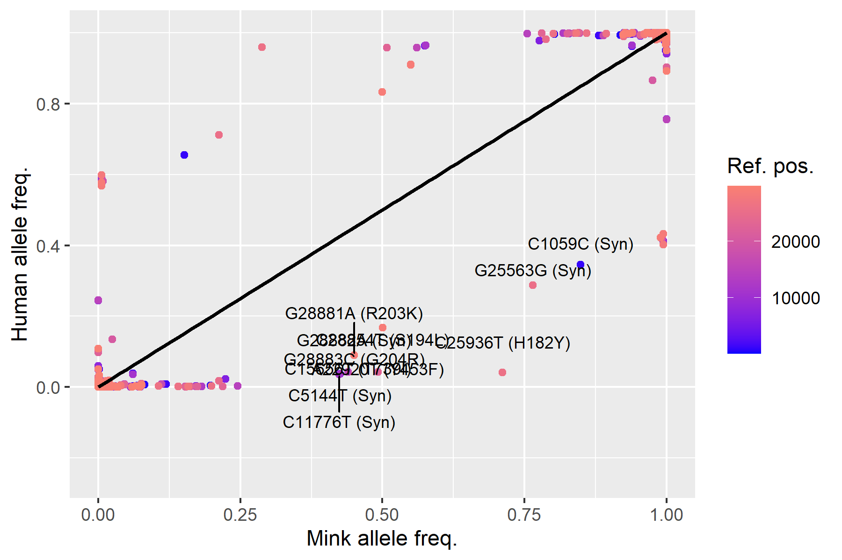
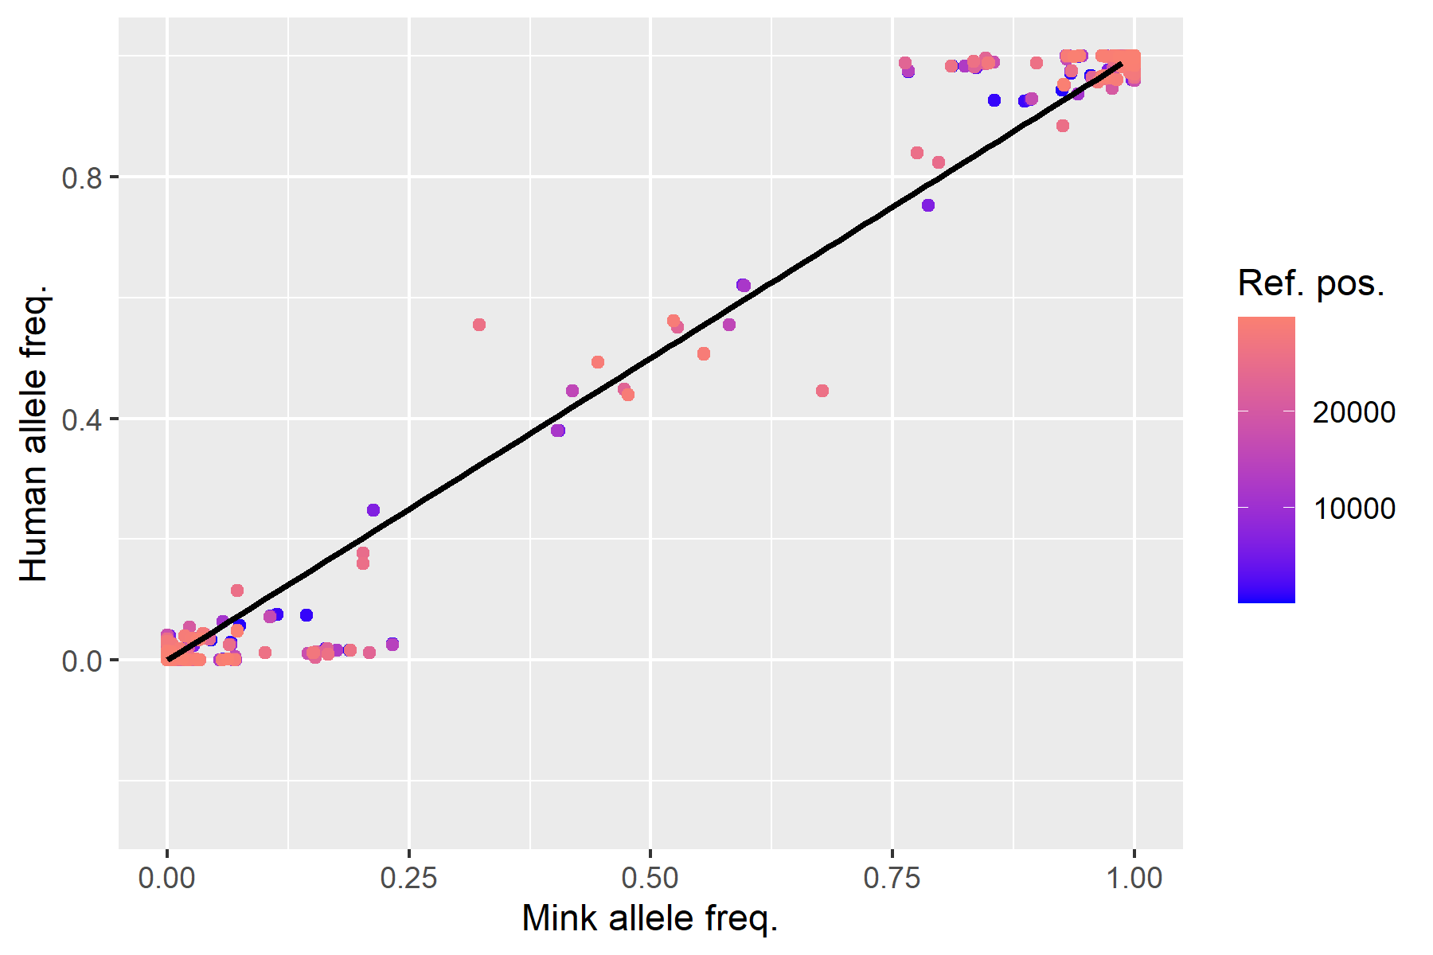
10 isolates per lineage, temporally unconstrained
All isolates within the same country + temporally constrained
Lineages in animals only + temporally constrained
Number of human isolates per lineage matches that of animal isolates + temporally constrained

Slide 37



10 isolates per lineage, temporally unconstrained
All isolates within the same country + temporally constrained
Lineages in animals only + temporally constrained
Number of human isolates per lineage matches that of animal isolates + temporally constrained

Slide 38
Human background affects allele frequency
97% of B.1.2 has NS3_G172V (G25907T)
36/73 deer were assigned B.1.2 resulting in allele frequency of
V1: 10 per lineage all-time
V2: restricted sampling dates, random subsample
V3: restricted sampling dates, 10 per lineage
V4: restricted sampling dates, only lineages in animals
V5: restricted sampling dates, match lineages in animals
V6: 10 per lineage global

Slide 39
We have to constraint lineages
V4
Pos 28869 (ref C)
B1.2 lineage (~0.99 T)
Human isolates from this lineage: 7103/12416
Animal isolates from this lineage: 4/739

Slide 40





Slide 41





Slide 42






n = 705
n = 776
(a)
(b)
n = 72
n = 73

Slide 44

T229I
N501T
Y453F
Mink-specific
G37E
L219V
F486L
Deer-specific
D377Y
I82T
L1035F
COVID-19 Timeline

Slide 45

(a)
T229I
N501T
Y453F
Mink-specific
G37E
L219V
F486L
Deer-specific
D377Y
I82T
L1035F
COVID-19 Timeline
(b)

Slide 46


(a)
T229I
N501T
Y453F
Mink-specific
G37E
L219V
F486L
Deer-specific
D377Y
I82T
L1035F
Ongoing transmission
COVID-19 Timeline
(b)
64 countries
57 countries
166 countries
166 countries
69 countries
(c)

Slide 47

Ongoing transmission

Slide 48






(a)
NSP3a_D178Y (spillover effect)
(b)
Spillover events
Spike_F486L (Not spillover effect)

Slide 49


Slide 50


Slide 51


Slide 52
(a)
HADDOCK
Spike structure | Human ACE2 | Mink ACE2
WT (Wuhan-Hu-1) | -137.0 | -152.5
Y453F | -145.0 | -155.1
F486L | -139.8 | -159.5
N501T | -137.6 | -148.7
(b)
mCSM-PPI2
Substitution performed | Human ACE2 | Mink ACE2
Y453F | -0.083 | -0.496
F453Y | 0.359 | 0.759
F486L | -0.936 | -0.504
L486F | 0.401 | 0.224
N501T | 0.882 | 1.223
T501N | -0.674 | -0.812

